Slide 1
CAREO Seed Grants
Growing Ideas…Together!

Slide 2
CAREO Seed Grants
The Center for Agricultural Research, Engagement & Outreach (CAREO) was established to expand the impact of Virginia State University’s 1890 Land Grant Mission through integrated research and extension, outreach and university collaboration.
CAREO Seed Grants have been established to increase VSU’s research portfolio, while addressing issues pertaining to:
USDA/NIFA Priorities
1890 Land Grant Mission
New Virginia Economy Strategic Plan

Slide 3
Through CAREO we invite everyone to extend VSU’s land grant reach!

Slide 4
$400,000 is available for 2017!
To encourage collaboration, awards will be funded as follows:
Up to $50,000 awards – A proposal from faculty located within one division or department (i.e. Art & Design Department)
Up to $100,000 awards - A joint proposal from faculty located within more than one division or department at VSU (i.e. the Department of Accounting & Finance and the Department of Management & Marketing)
Up to $150,000 awards - A joint proposal from faculty located within more than one college at VSU (i.e. College of Engineering & Technology and the Reginald F. Lewis College of Business)

Slide 5
Research and/or Extension Emphasis
Each proposal must include…
A research emphasis that builds upon or adds to current research being addressed within VSU’s Agricultural Research Station.
For more information refer to: http://www.agriculture.vsu.edu/agricultural-research-station/index.php
An extension/outreach emphasis that builds upon or adds to VSU/Virginia Cooperative Extension’s focus AND offers a program(s) or service(s) that may be made available to the general public.
For more information refer to: https://www.ext.vsu.edu/

Slide 6
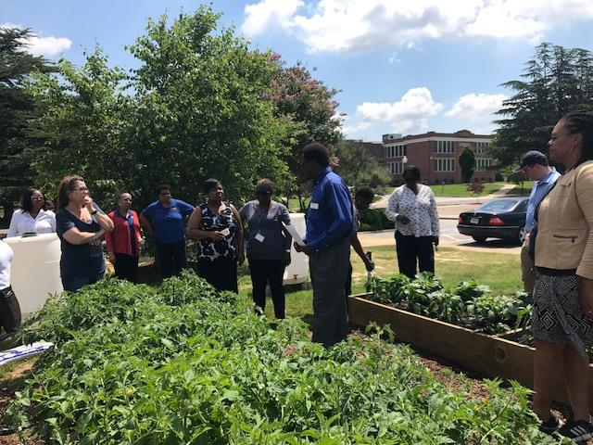
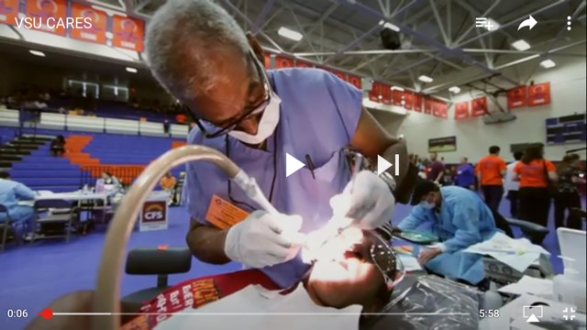
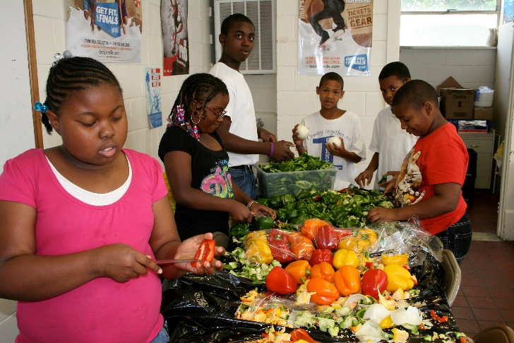
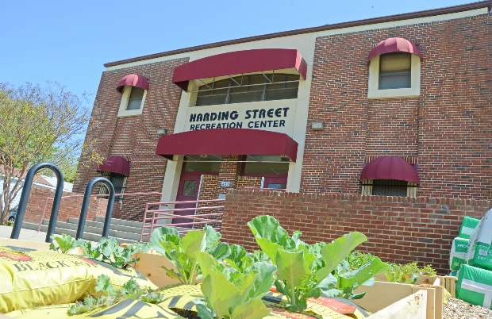
CAREO Seed Grant Program Emphasis
Food Security and Hunger/Urban Agriculture
Human Health & Nutrition
STEAM and Entrepreneurship Education
Agriculture-Based Business Development

Slide 7
We can grow ideas together!
College of Humanities & Social Sciences:
Art & Design - Develop a local “Farm-Art Trail” to enhance the city-to-farm connection as part of Petersburg’s economic development plan
Sociology & Social Work/Criminal Justice/Economics - The sociological impact of Petersburg residents living in a food desert
College of Education:
Health/Nutrition/Physiology – Getting the most out of urban agriculture to improve nutrition/wellness in the Petersburg Community
Health & Mass Communication – Survey on the impact of health and nutrition messaging on eating behaviors

Slide 8
We can grow ideas together!
College of Natural and Health Sciences:
Nursing, Sociology/Social Work, Community Education, Agriculture - VSU CARES Dental Clinic
Biology – Goat Genome Community Annotation Project – Developing a shared annotation server for the goat genome at VSU
College of Agriculture:
Small Farm Outreach & Business – Saving the small family farm through financial and estate planning education
4-H Youth Development – Cultivating interests in STEM, Art and Agriculture through Kids Tech University

Slide 9
Together…our impact is greater!
Reginald F. Lewis College of Business
Marketing & Management: Marketing agricultural-based products grown at local farmer’s markets
The impact of urban agriculture entrepreneurship classes in Ettrick and Petersburg on career choices
College of Engineering & Technology
Mathematics & Economics: Using math and science to enhance the economic efficiency of farming on small plots
Technology: “GIS and Urban Agriculture…Assessing land suitable for urban agriculture

Slide 10
Fall 2017 Seed Grant proposals should be submitted via email by:
Sept. 30, 2017

Slide 11
Please submit proposals to:
Jewel H. Bronaugh, Ph.D.
Executive Director
Phone: 804-524-2740
jbronaugh@vsu.edu

